Slide 1
Course Title: Engineering Chemistry-1
Course Code: CHE109
(Chapter 4)
Dr. Joyanta Kumar Saha
Associate Professor
Department of Chemistry
Jagannath University

Slide 2
Properties of gases
A gas consists of molecules separated wide apart in empty space. The molecules are free to move about throughout the container.
PARAMETERS OF A GAS A gas sample can be described in terms of four parameters (measurable properties): (1) the volume, V of the gas (2) its pressure, P (3) its temperature, T (4) the number of moles, n, of gas in the container
BOYLE’S LAW : at constant temperature, the volume of a fixed mass of gas is inversely proportional to its pressure. If the pressure is doubled, the volume is halved.
The Boyle’s Law may be expressed mathematically as V ∝ 1/P (T, n are constant) or V = k × 1/P; where k is a proportionality constant. PV = k; If P1, V1 are the initial pressure and volume of a given sample of gas and P2, V2 the changed pressure and volume, we can write

Slide 3
P1 V1 = k = P2 V2 or P1 V1 = P2 V2
CHARLES’S LAW : At constant pressure, the volume of a fixed mass of gas is directly proportional to the Kelvin temperature of absolute temperature.
Charles’ Law may be expressed mathematically as V ∝ T (P, n are constant); or V = k T

Slide 5
Gay Lussac’s Law: at constant volume, the pressure of a fixed mass of gas is directly proportional to the Kelvin temperature or absolute temperature.

Slide 6
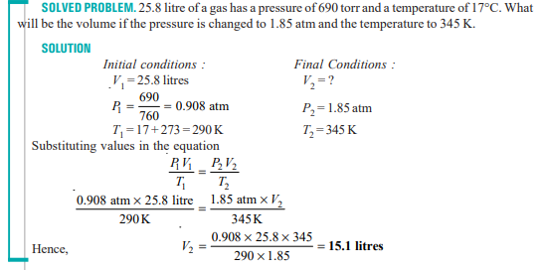

Slide 7
Avogadro’s Law: Equal volumes of gases at the same temperature and pressure contain equal number of moles or molecules.

Slide 8
Ideal Gas Law: the volume of a given amount of gas is directly proportional to the number of moles of gas, directly proportional to the temperature, and inversely proportional to the pressure.
The constant R is called the Gas constant.

Slide 11
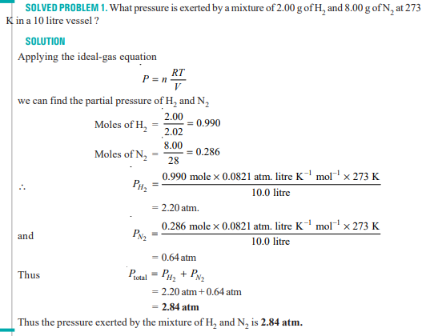

Slide 12
DALTON’S LAW OF PARTIAL PRESSURES: The total pressure of a mixture of gases is equal to the sum of the partial pressures of all the gases present. Mathematically the law can be expressed as Ptotal = P1 + P2 + P3 ... (V and T are constant) where P1, P2 and P3 are partial pressures of the three gases 1, 2 and 3; and so on

